Slide 1

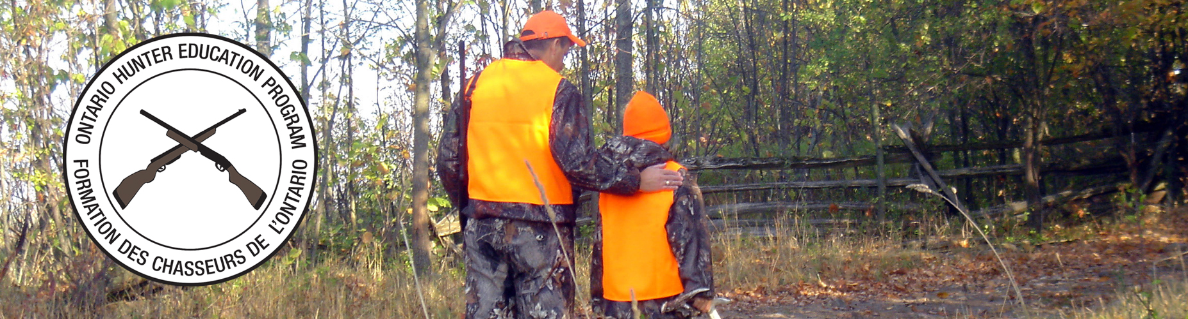
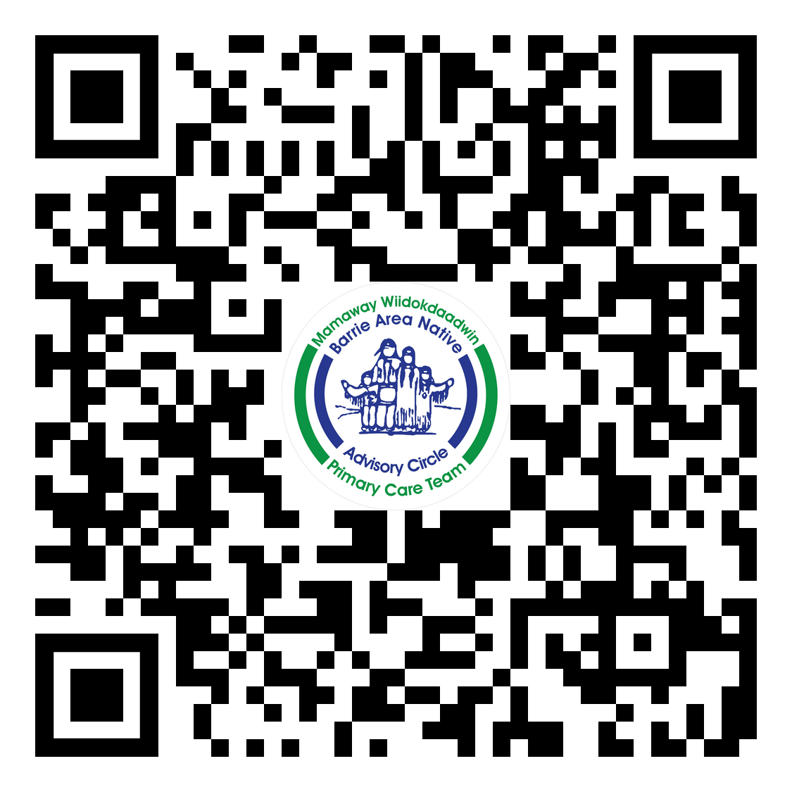

Harvesters Safety Training
What: Two day Firearms Safety and Hunter Safety Course
Where: 110 Matchedash St. Orillia must be registered to attend the 2 day training
When : May 13th and May 14th
Day 1 starts at 8 am – 6 pm Firearms Safety
Day 2 starts at 8 am until 5 pm Hunter Safety
Please Register at www.mamaway.ca/events or scan the QR
Code.

